Slide 1
IJS Vision 2026
Goal : Prepare the school lawn to use as a
outdoor RECPTION lawn
For
Marriages Birthdays Anniversaries.
Outdoor VBS studies.
Outdoor Performance.
Outdoor Competitions.

Slide 2
—School lawn—
Set up one court ( badminton & pickle ball) - removable net and pole - $150
Concreting for badminton court - Electrical and Water connection to trees before concreting - $1500?
Wood top and wood bottom/AalThara on entry tree to block the sap but don’t catch the leaves - $500
Paint the stage - $50
Plant tall bougainvillea behind the stage to cover the houses - $100
Portable stage at the entry/middle - $500
Nursing station portable - $300
Playhouse under the tree - $300

Slide 3
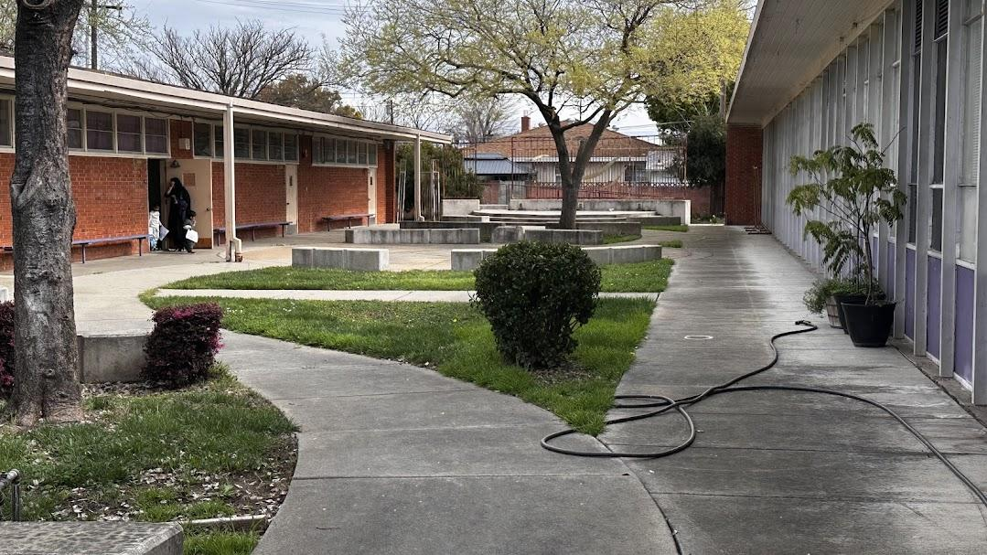
Church lawn - original

Slide 4
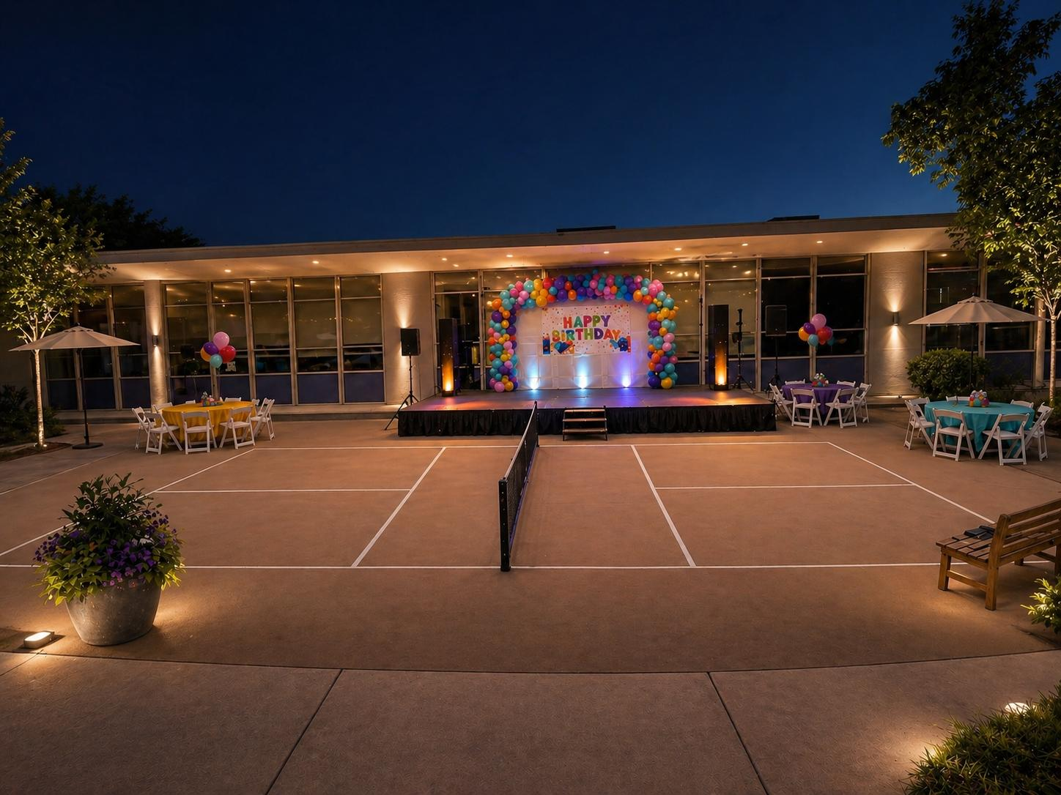
Church lawn - Birthday stage - 1

Slide 5
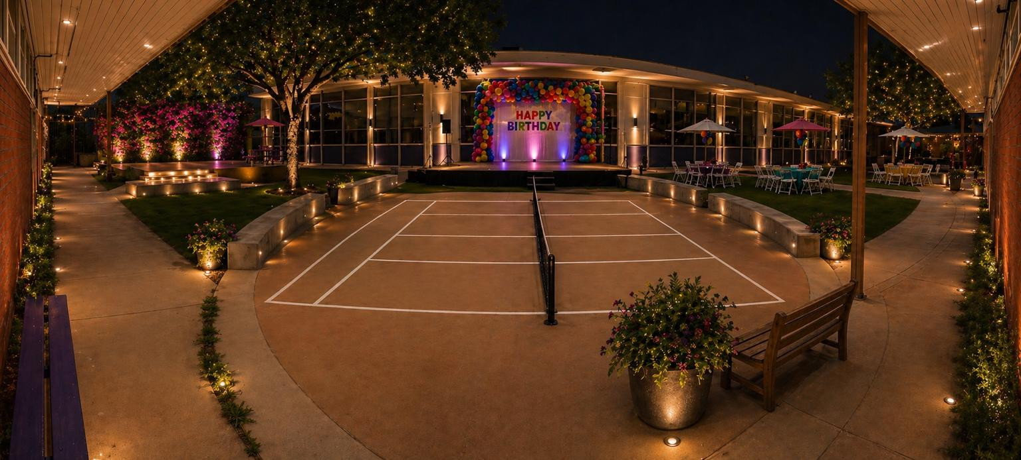
Church lawn - Birthday stage - 2

Slide 6
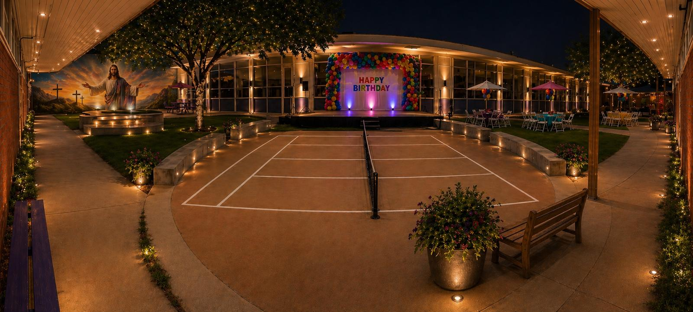
Church lawn - Birthday stage - 3

Slide 7
Church lawn - Birthday stage - 4

Slide 8
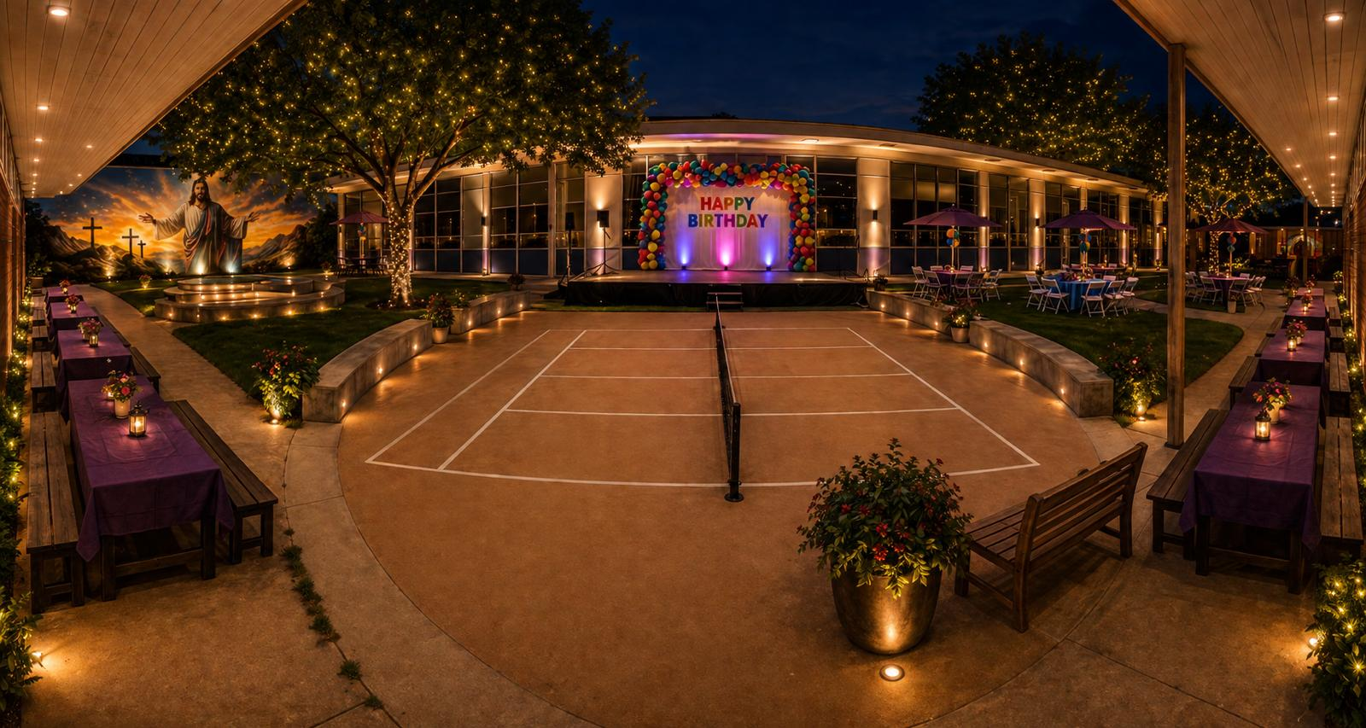
Church lawn - Birthday stage - 5

Slide 9
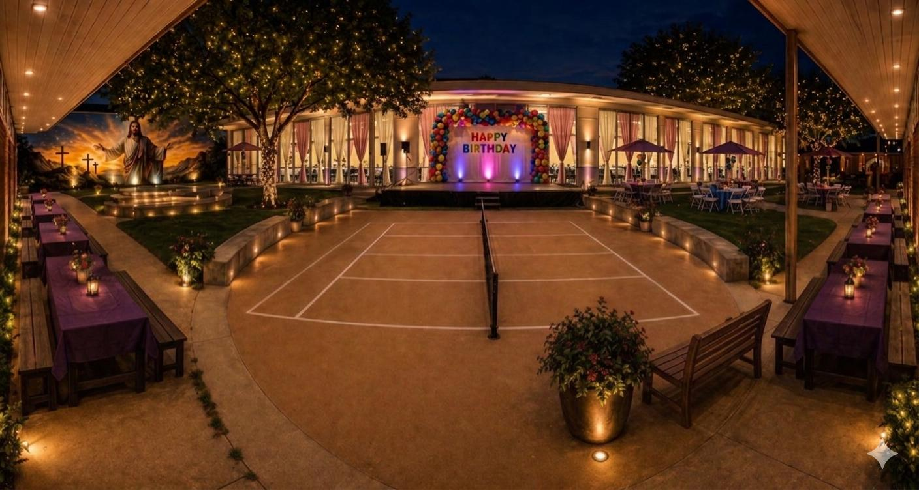
Church lawn - with curtain 1

Slide 10
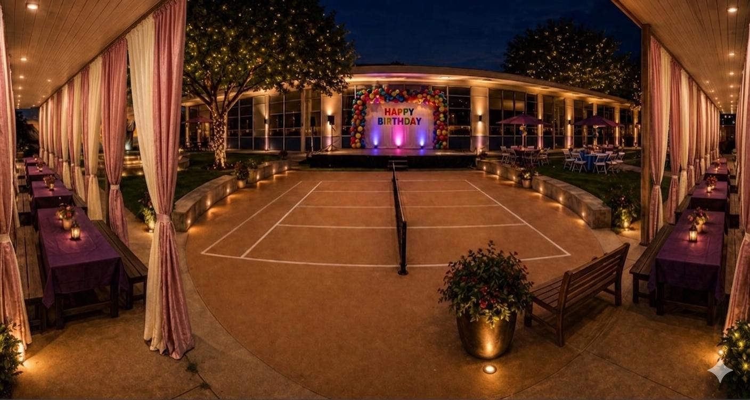
Church lawn - with curtain 2

Slide 11
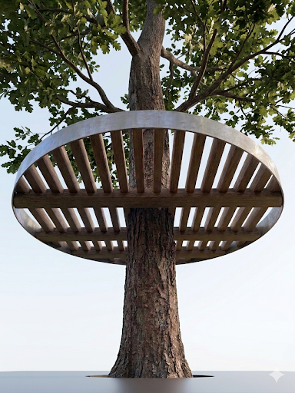
Church lawn - platform - top

Slide 12
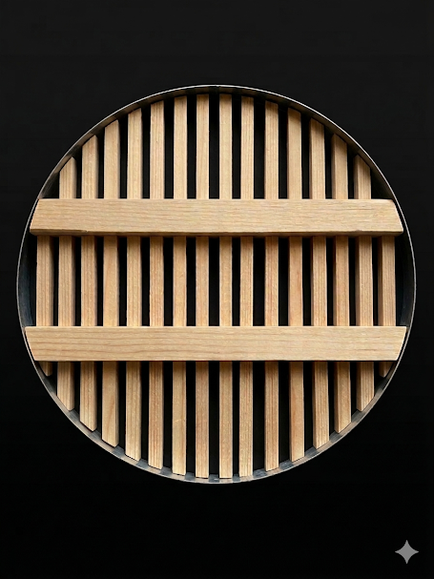
Church lawn

Slide 13
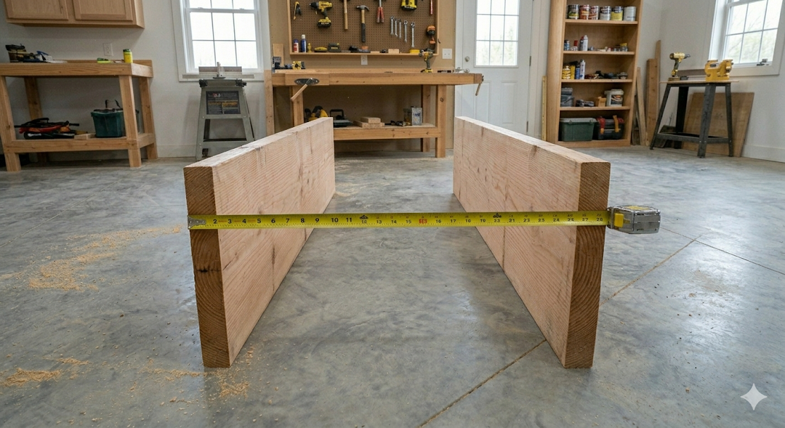
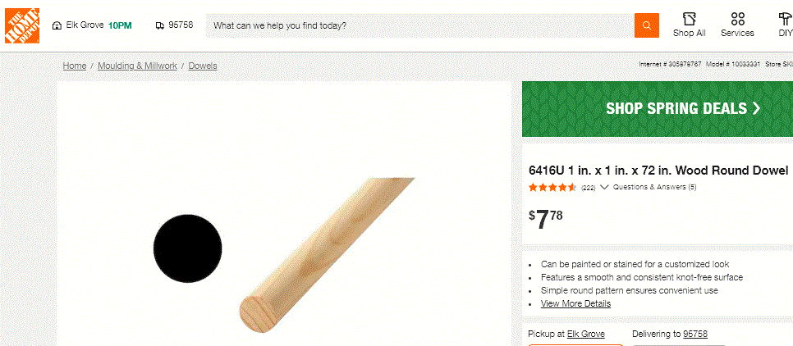
Church lawn - materials

Slide 14
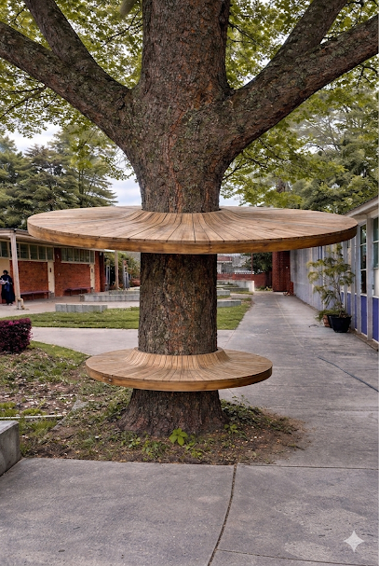
Church lawn

Slide 15
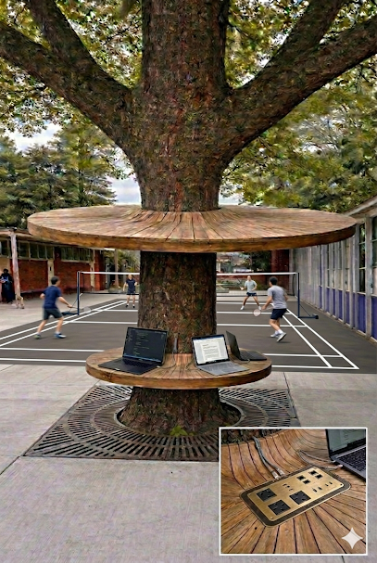
Church lawn - with Court

Slide 16
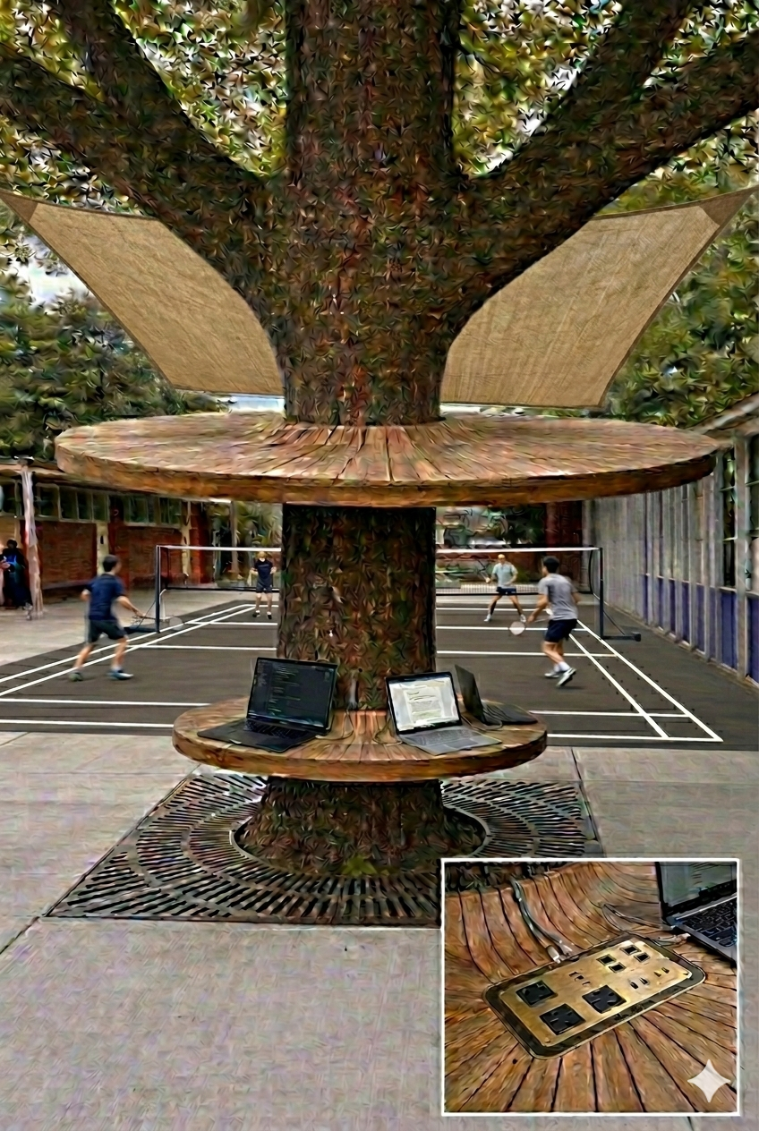
School lawn - with court - and - canopy

Slide 17
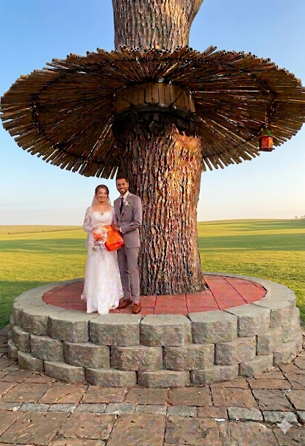
Church lawn -
Aalthara as stage
On
Entry tree

Slide 18
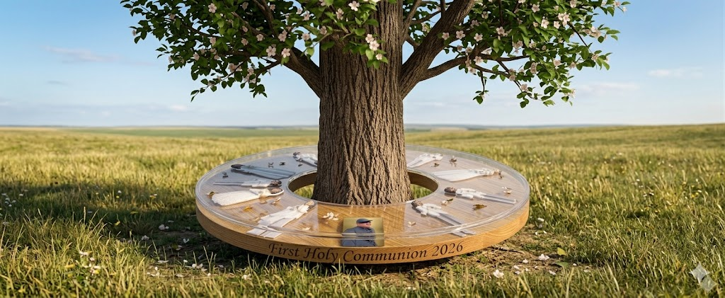
Church lawn - aalThara top with clearResin
( holy Communion )photo

Slide 19
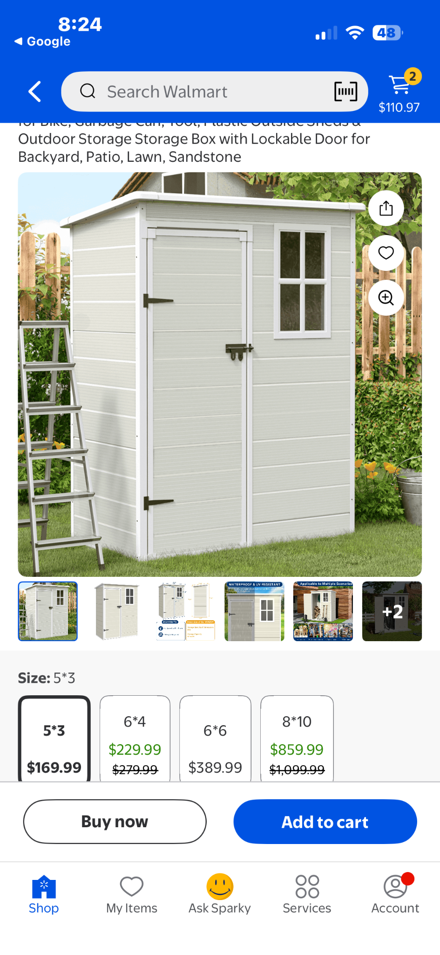
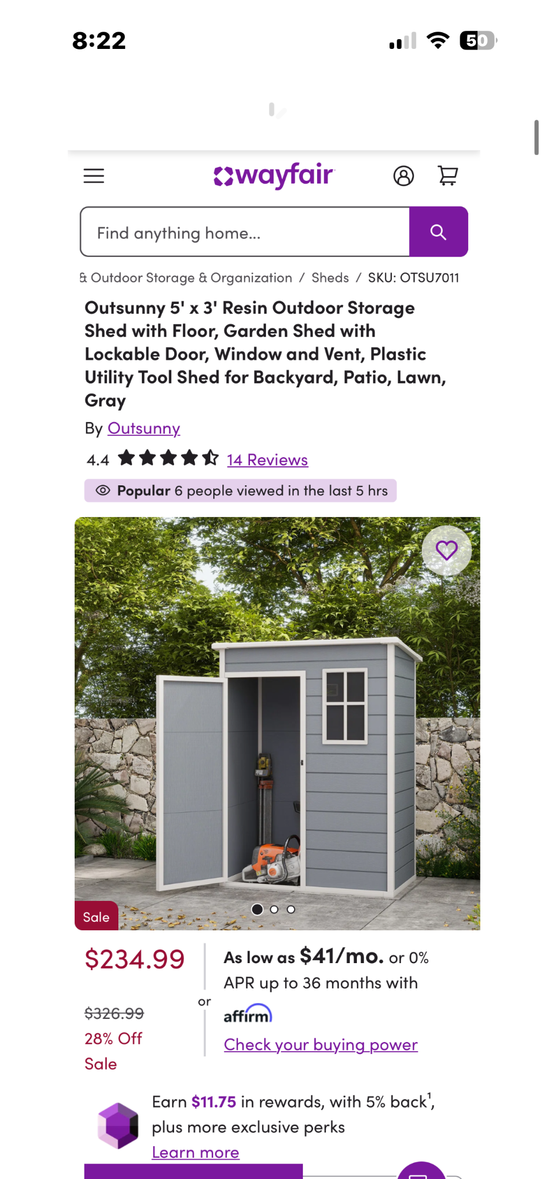
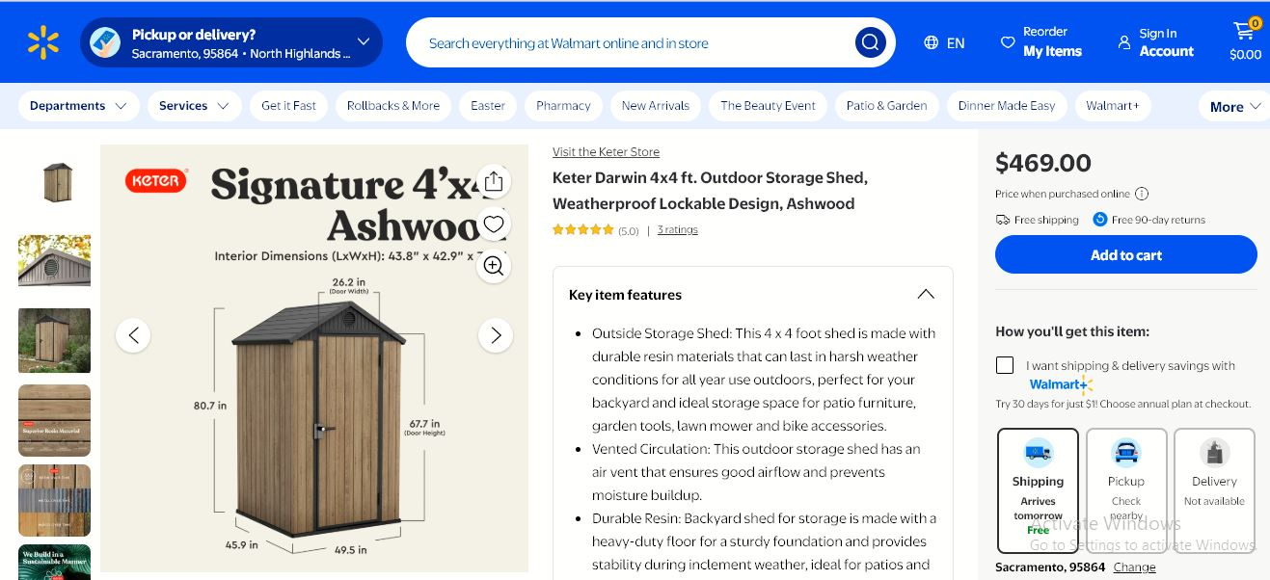
Church lawn - Nursing station - using - storage shed

Slide 20
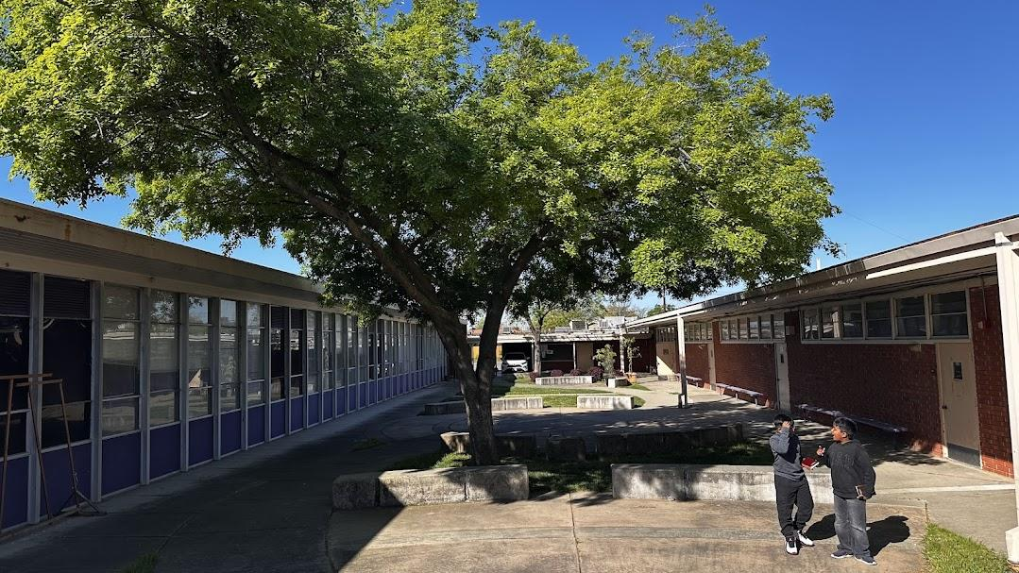
Church lawn - original - Engineer is explaining the construction plan

Slide 21
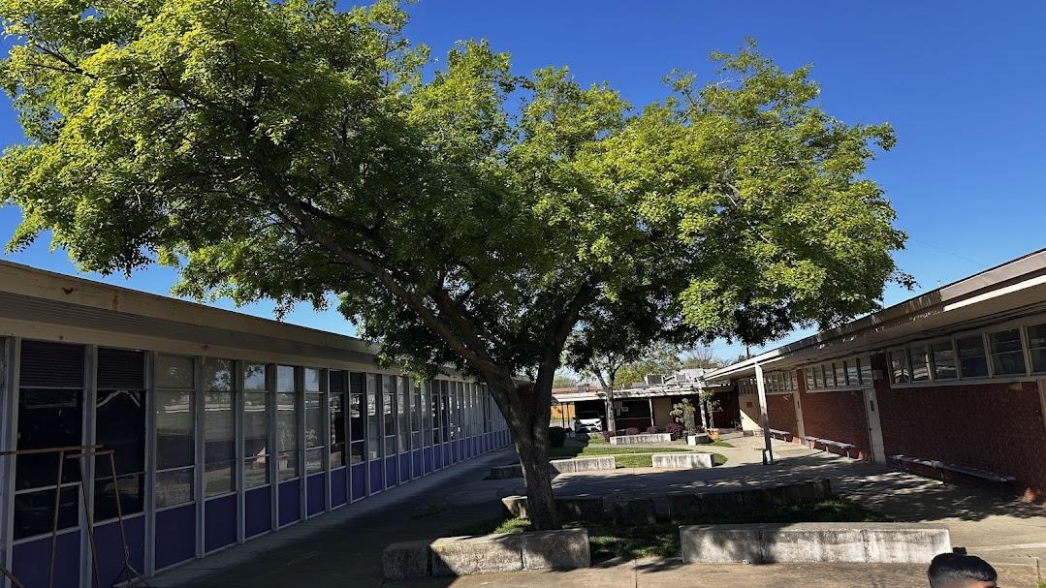
Church lawn - Original

Slide 22
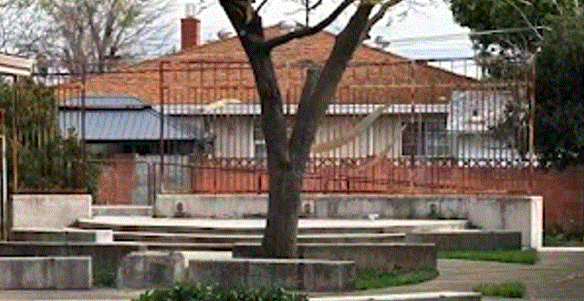
Church lawn - stage - before

Slide 23
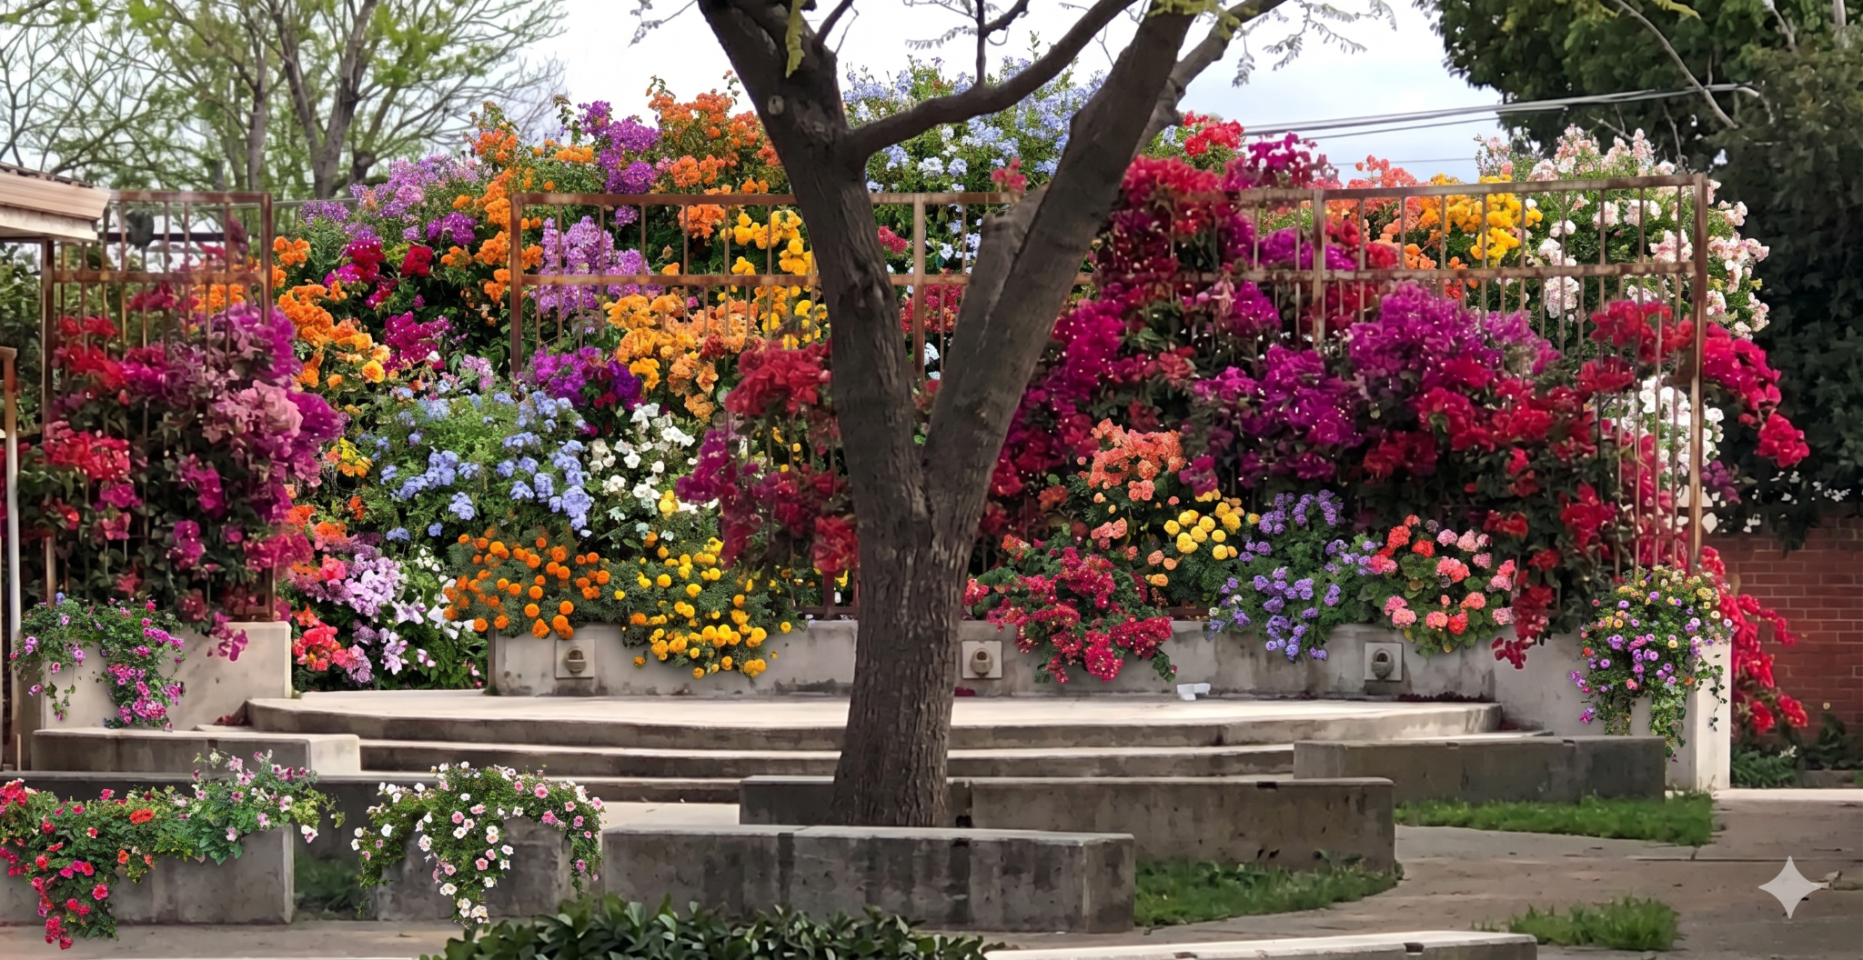
Church lawn - stage - after

Slide 24
For more details:
https://ijs-vision-2026.vercel.app/

